Slide 1
VAST 2019 Mini Challenge 1
DONE BY
Ashini Anantharaman
Mithila Nigudkar
Niranjana Sathish Avilery
SaiTulasi Kamma

Slide 2
Outline
Problem Description
VAST Challenge Dataset
Data Exploration
Visualizations and Analysis
Future Scope and Conclusion

Slide 3
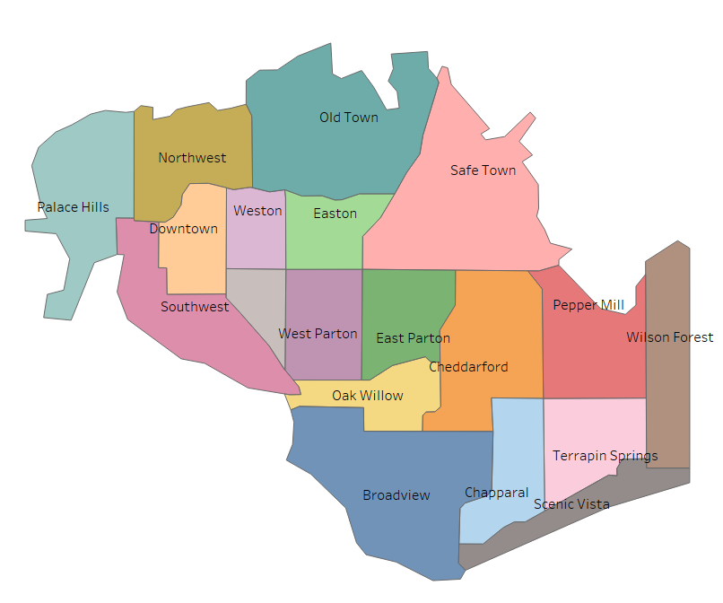
How is this dataset used?
Problem Description
Assess the effect of an earthquake using app responses and shake maps to determine areas of concern and advise emergency planners

Slide 4
Outline
Problem Description
VAST Challenge Dataset
Data Exploration
Visualizations and Analysis
Future Scope and Conclusion

Slide 5
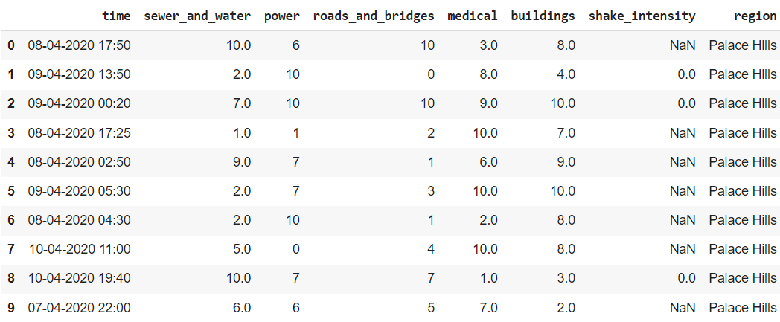
VAST Mini-Challenge 1 Dataset
What it is about?
How this dataset was obtained?
The goal of this phase is to determine the extent of destruction and allocate limited resources to the most vulnerable areas.
A mobile application allows citizens to report damage to the city more quickly, improving their understanding of the damage and prioritizing the response

Slide 6

QUESTIONS?
How to prioritize the neighborhood
Which parts are most affected
Uncertainty on the data
Reliability in neighborhood reports
Change of conditions over time

Slide 7
Summary Statistics
Future Work
PROCESSES INVOLVED
Location based Analysis
Data Uncertainty/Reliability
Timeline Analysis

Slide 8
Outline
Problem Description
VAST Challenge Dataset
Data Exploration
Visualizations and Analysis
Future Scope and Conclusion

Slide 9
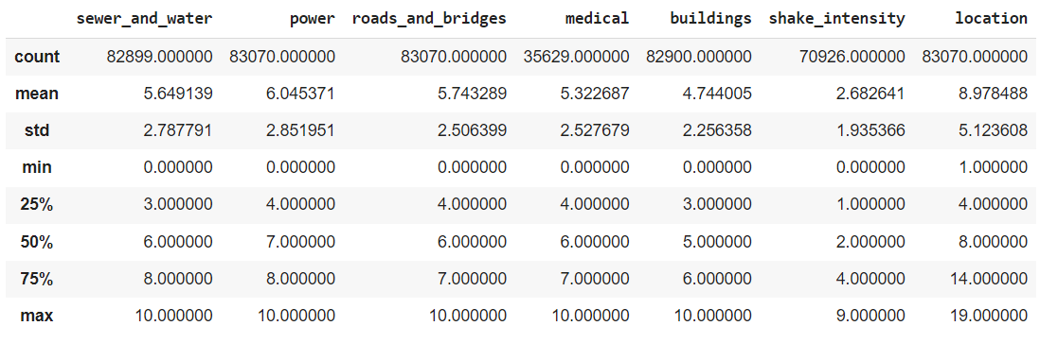
Data Exploration

Slide 10
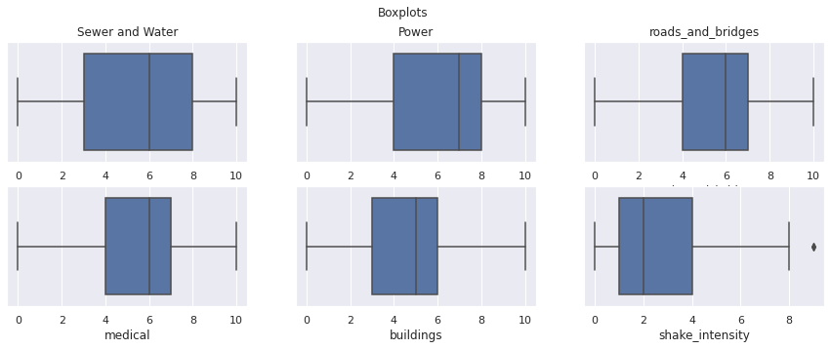
Box Plot-Mean Values

Slide 11
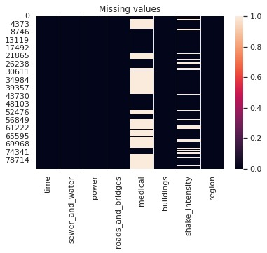
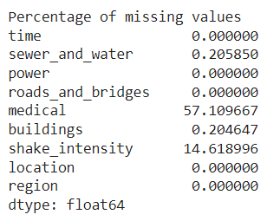
Missing Values

Slide 12
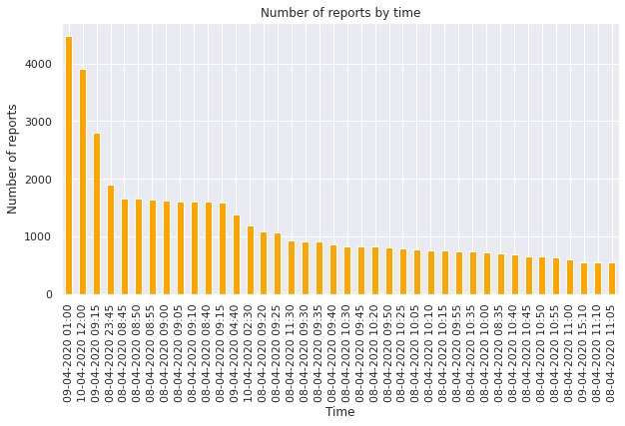
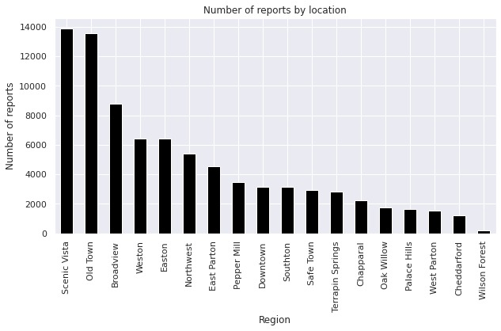
Number of reports with Time and Location

Slide 13
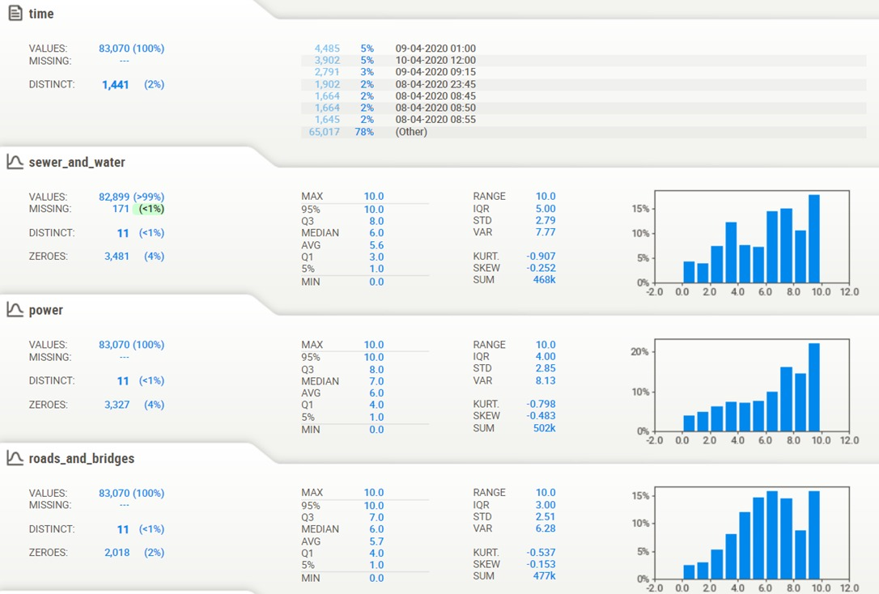
Summary Statistics - Report

Slide 14
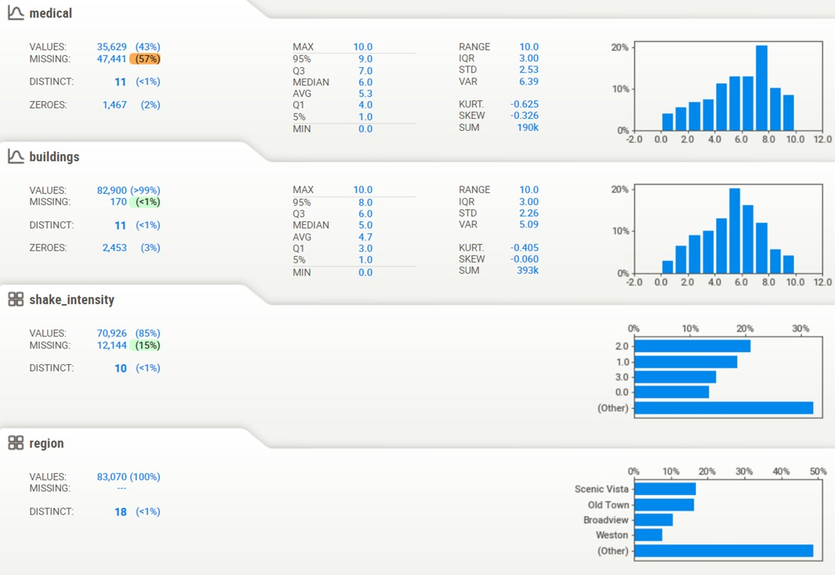
Summary Statistics - Report

Slide 15
Outline
Problem Description
VAST Challenge Dataset
Data Exploration
Visualizations and Analysis
Future Scope and Conclusion

Slide 16
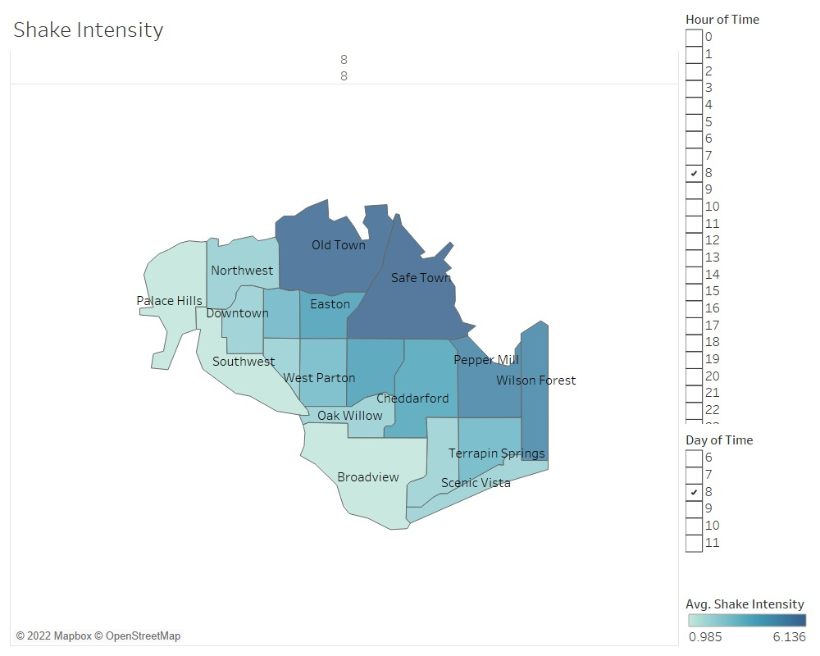
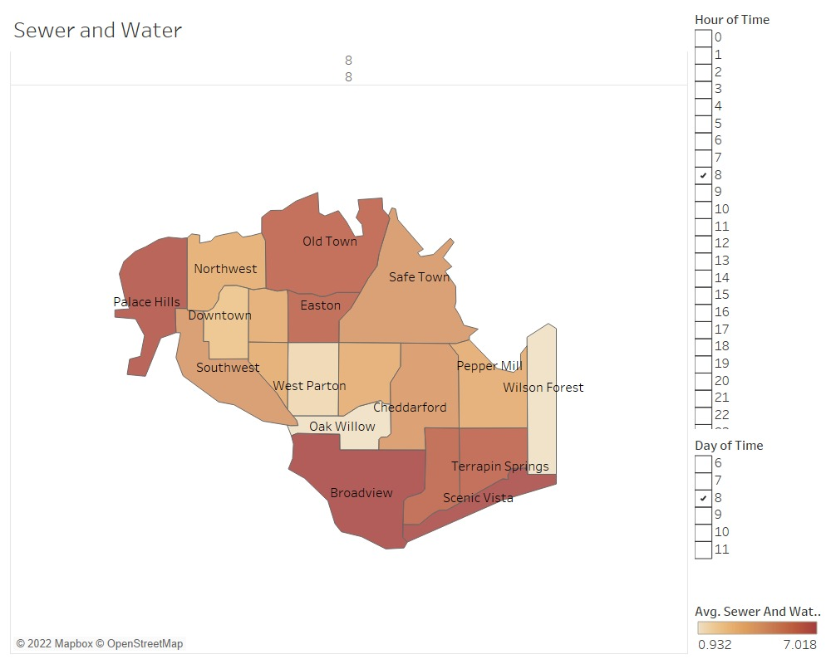
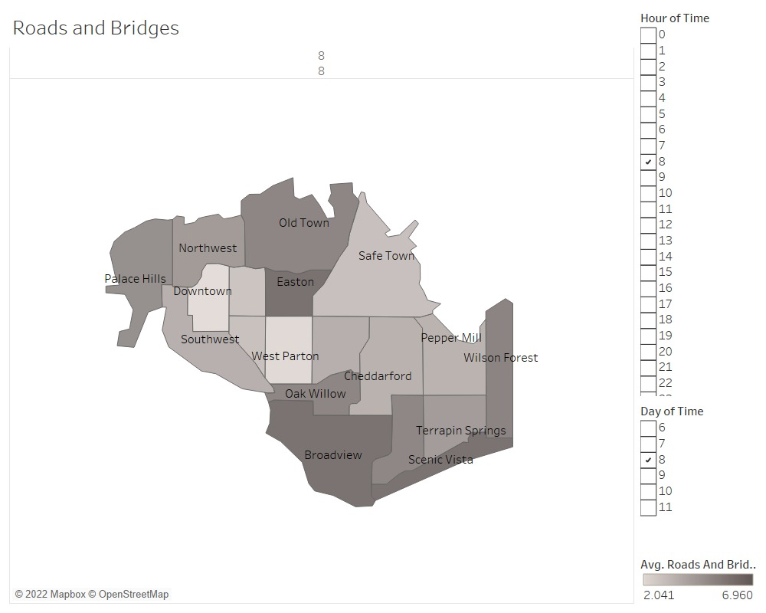
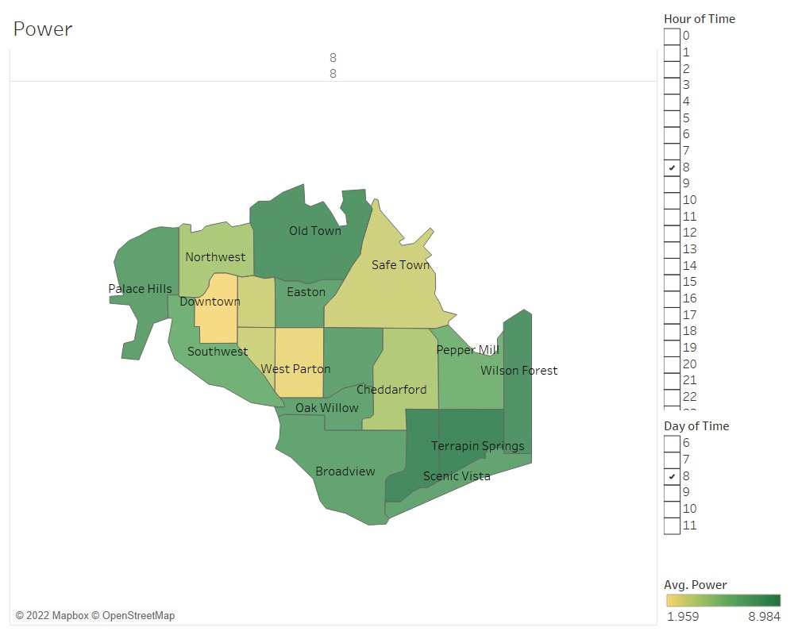
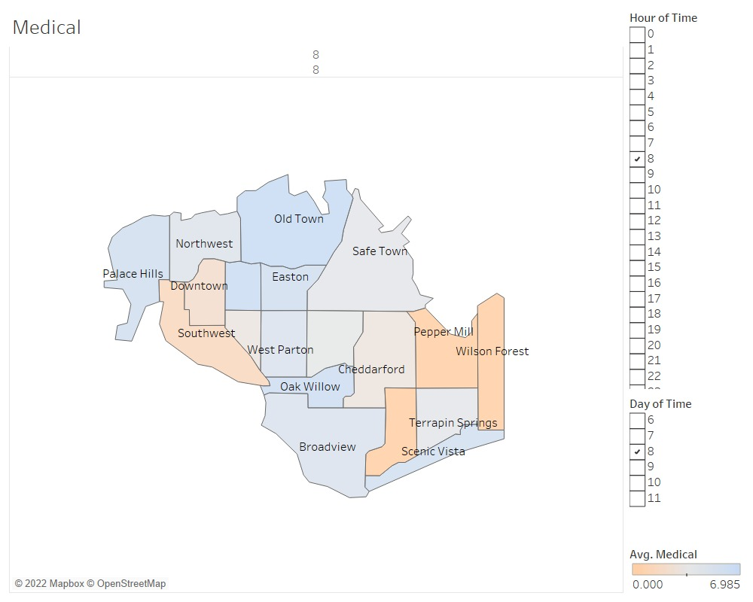
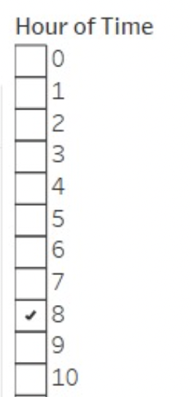
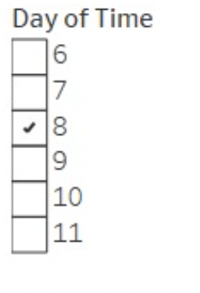

Slide 17
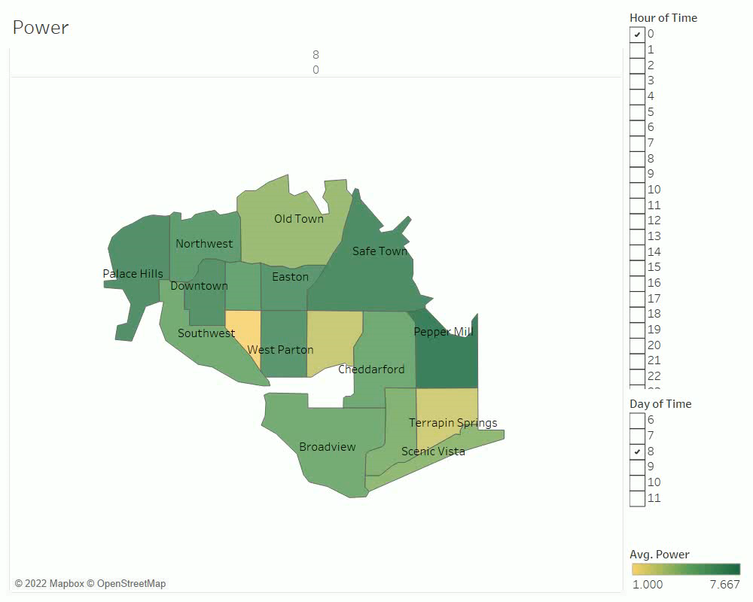

Slide 18
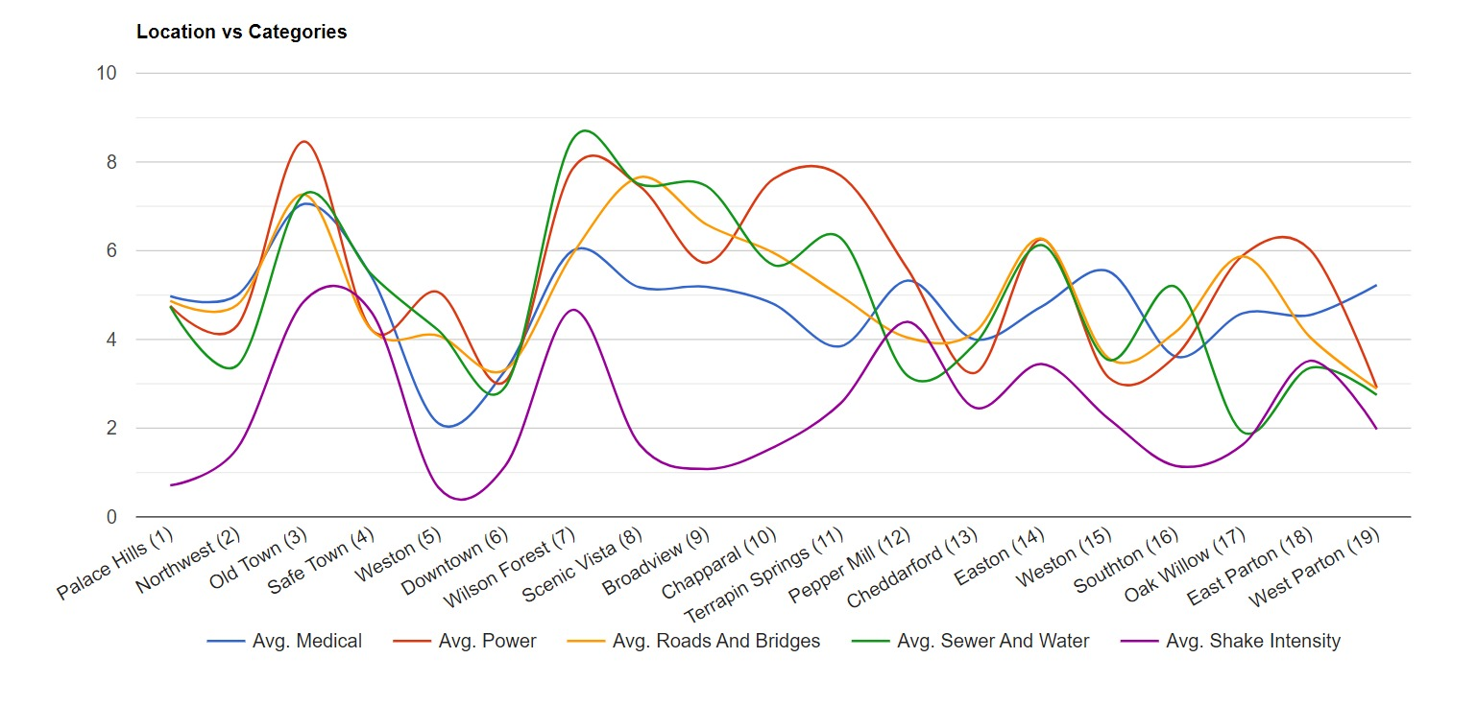
Average Measure (vs) Location

Slide 19
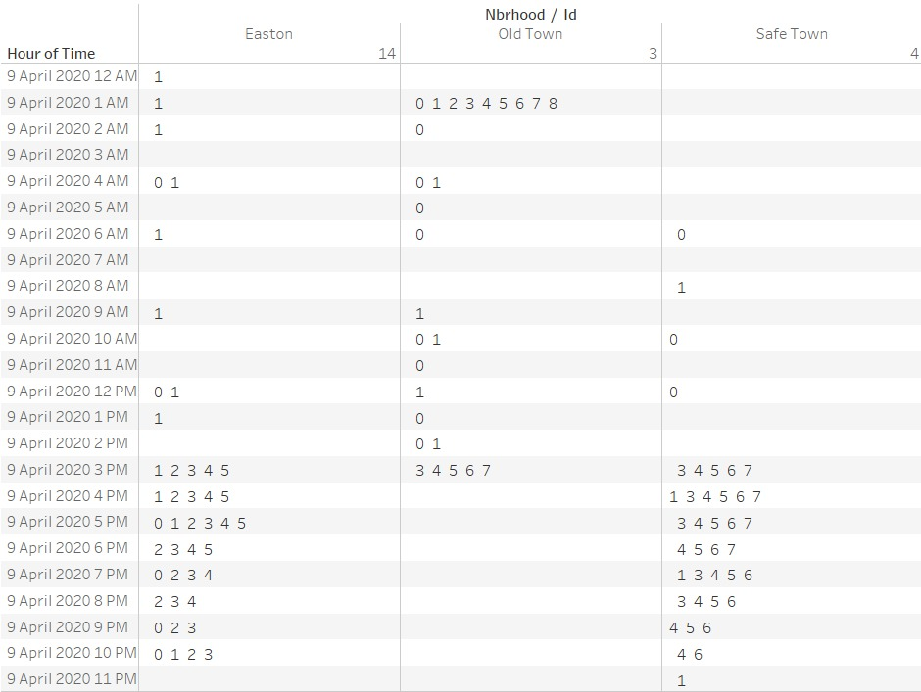
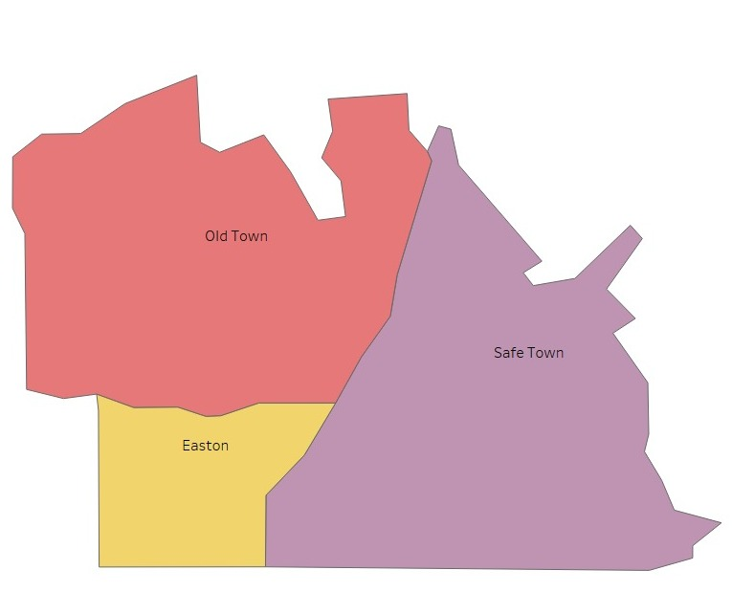
Neighborhood Rating Comparison

Slide 20
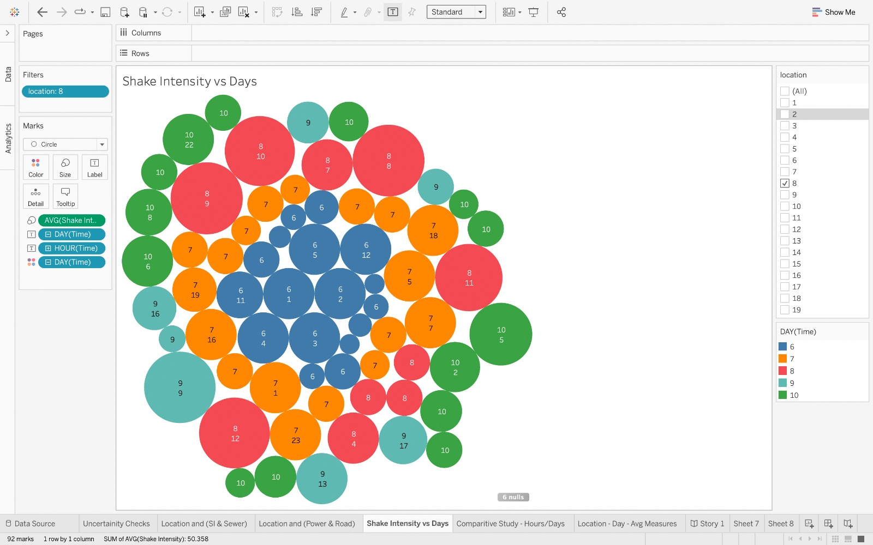
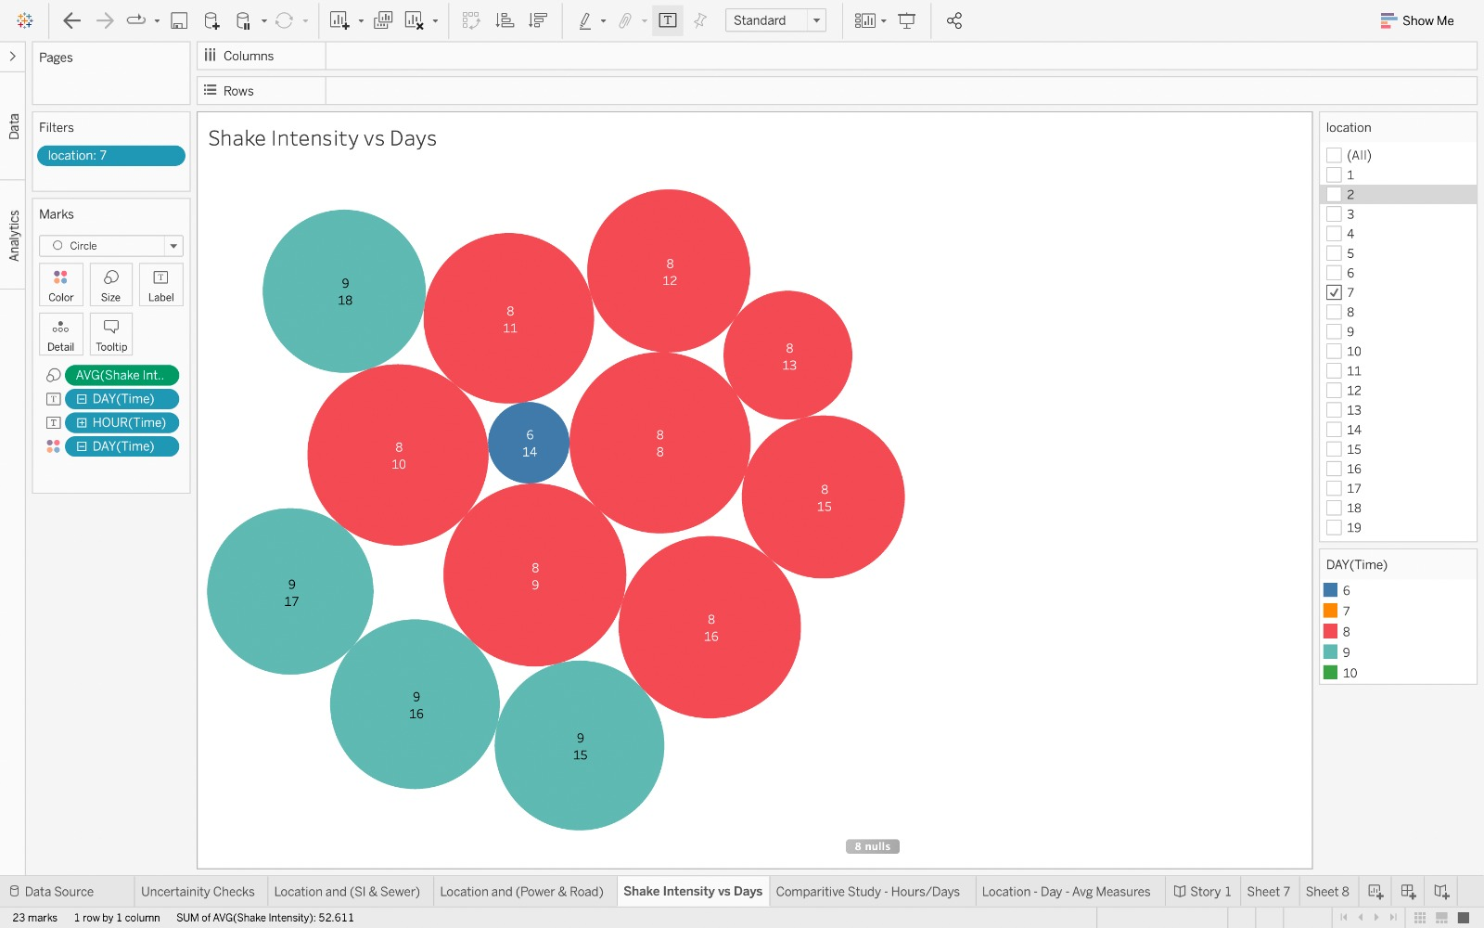
Average Shake Intensity
Location 8 - Scenic Vista
Location 7 - Wilson Forest

Slide 21
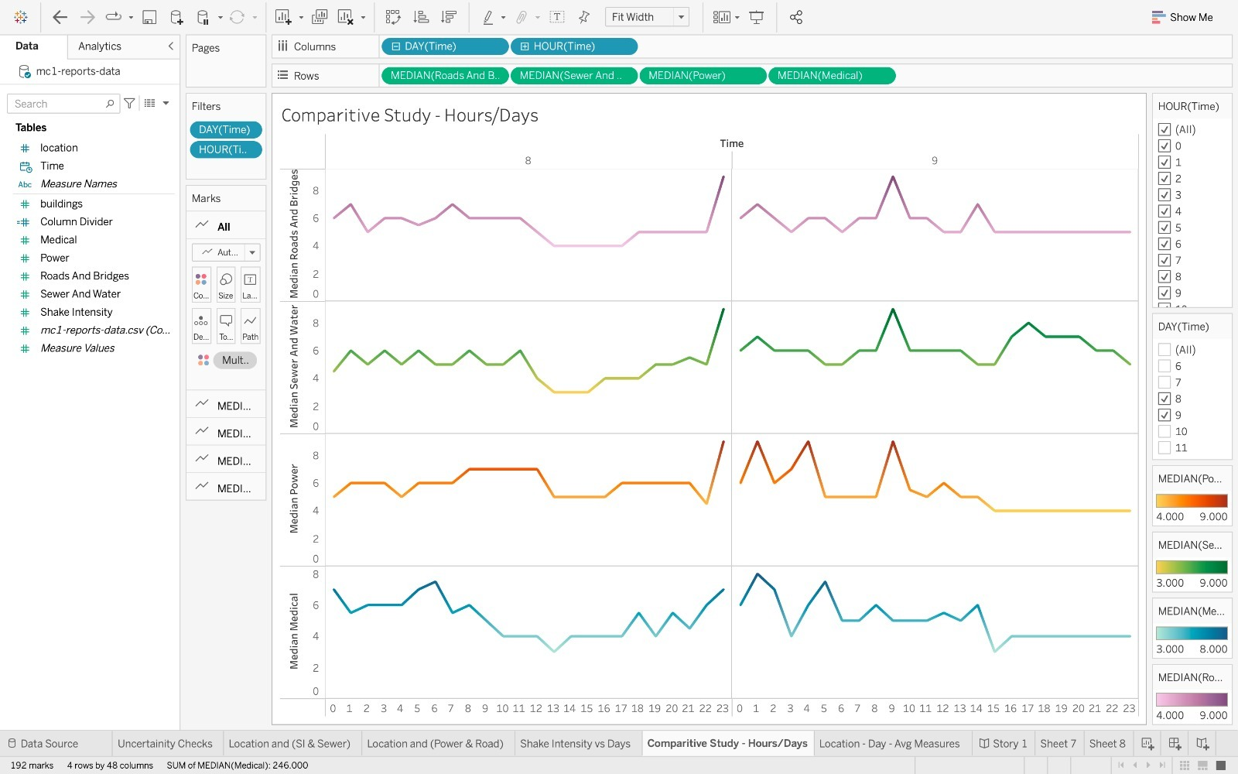

Slide 22



Slide 23
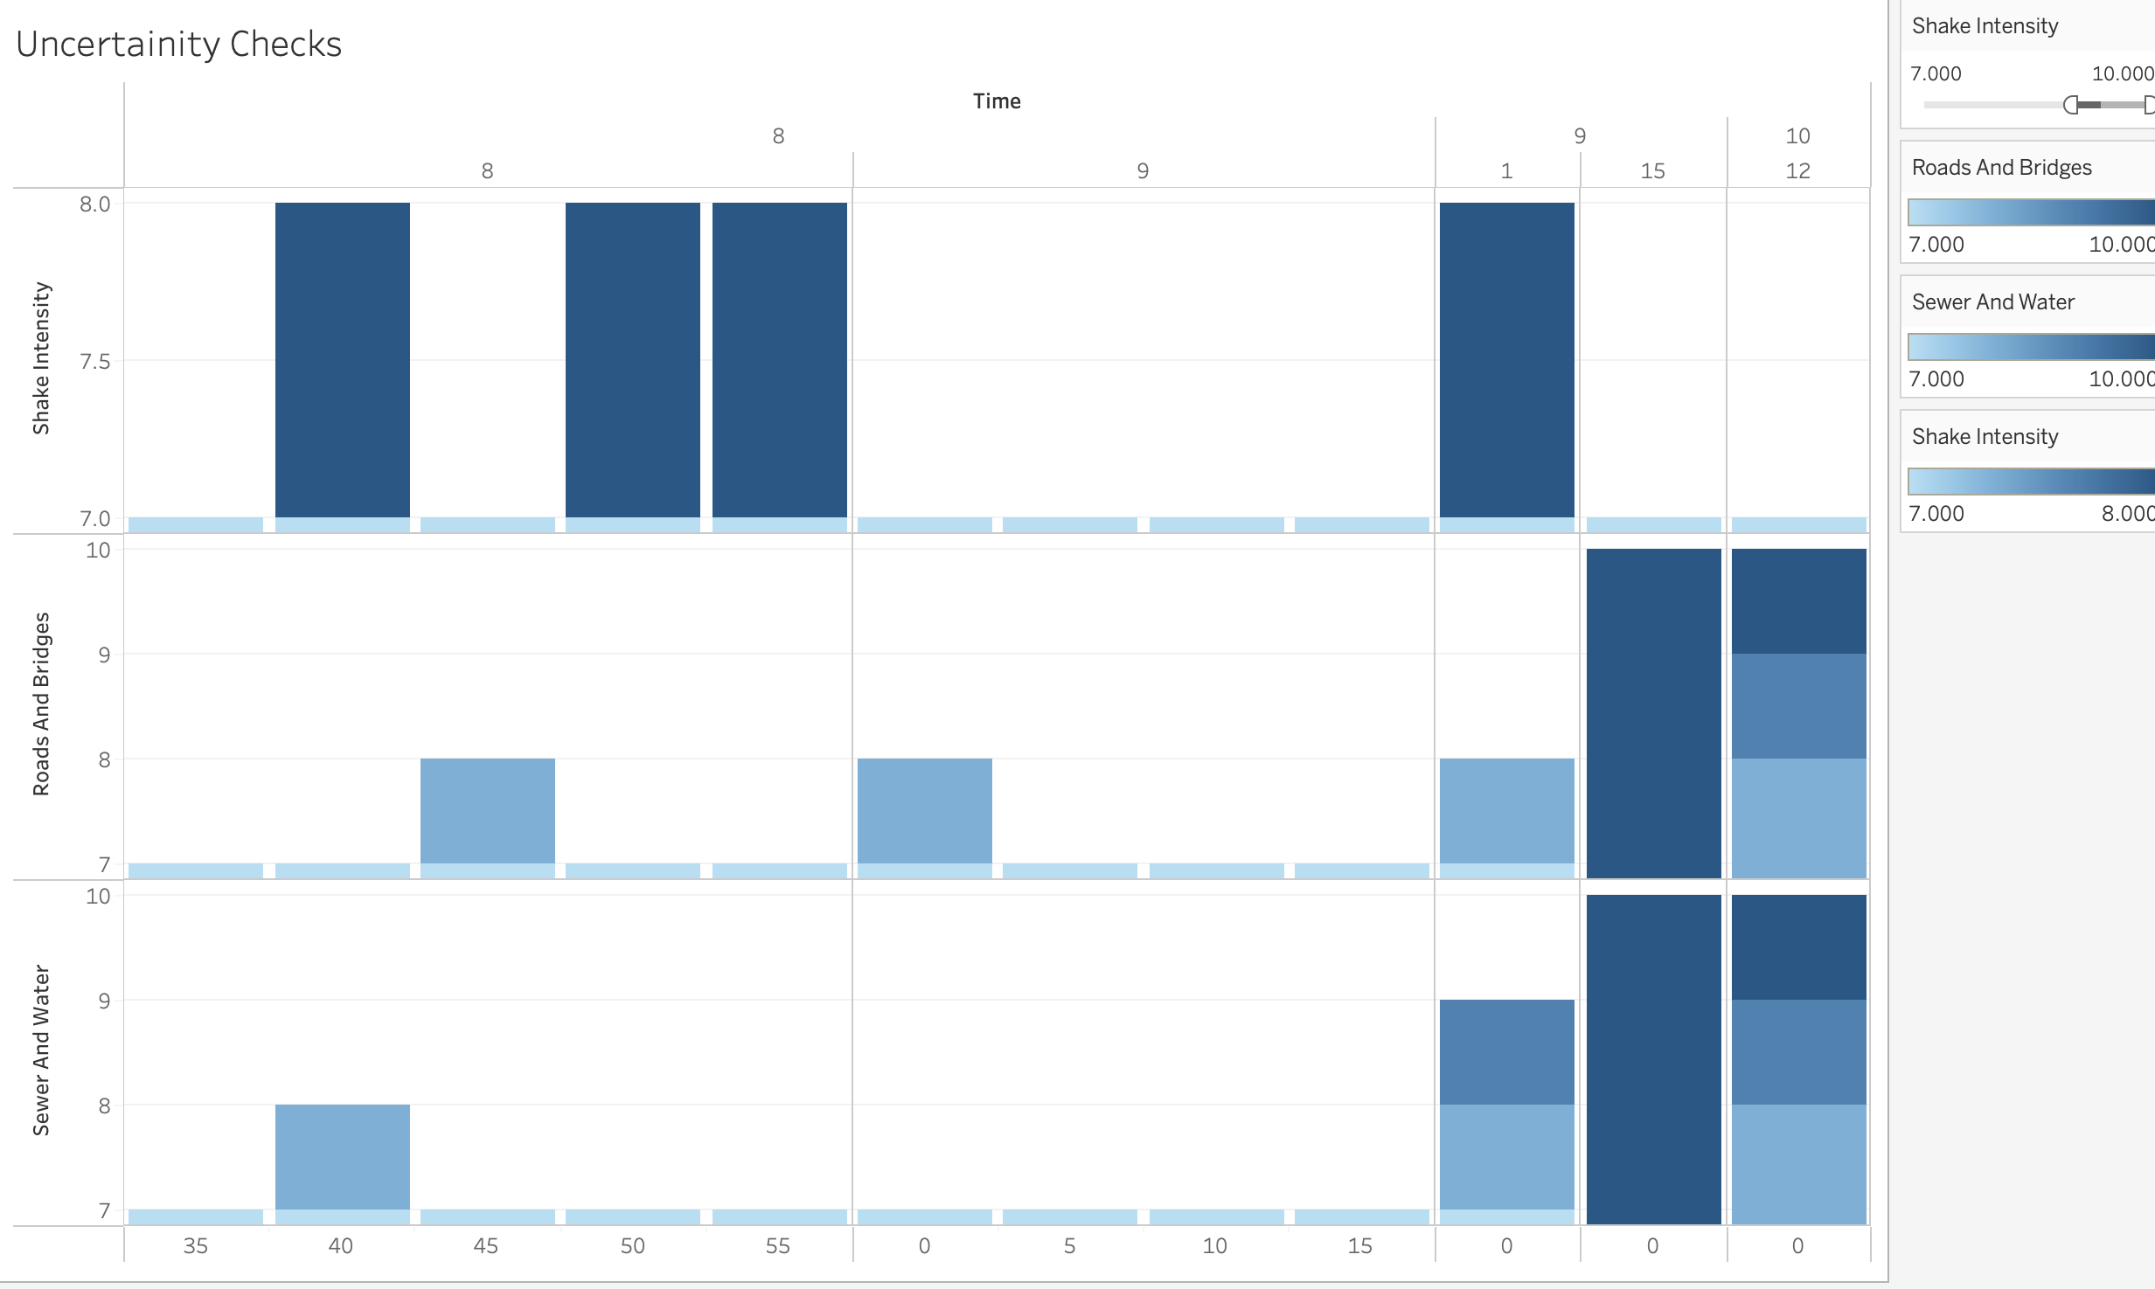

Slide 24
Limitations
Time consuming results
Insufficiently granular information
Data has certain limitations

Slide 25
Outline
Problem Description
VAST Challenge Dataset
Data Exploration
Visualizations and Analysis
Future Scope and Conclusion

Slide 26
Future Scope
An efficient approach such as Bayesians time series can be used.
As the results obtained are time consuming, Limit the results to 100 words and 5 images.
The data for this challenge can be analyzed as either static or dynamic stream of data. How do we deal with such dataset available.

Slide 27


Slide 28
THANK YOU

